Slide 1
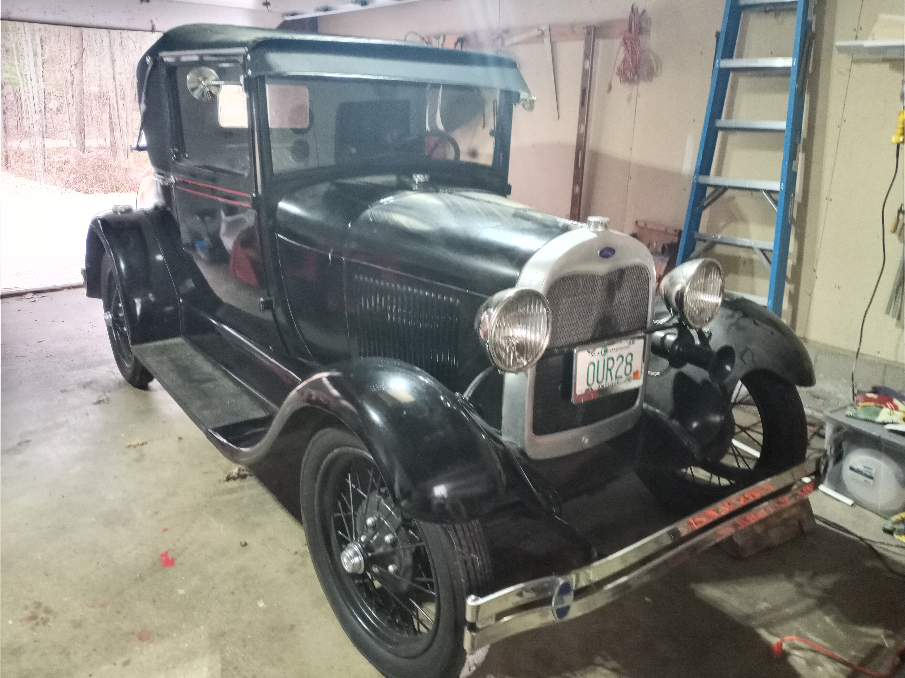
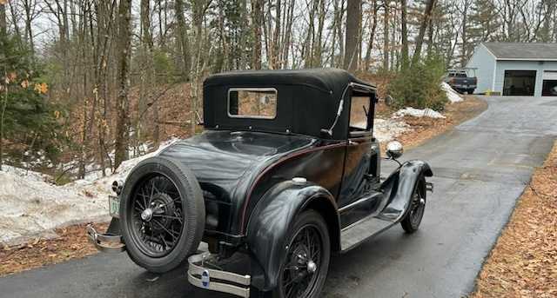
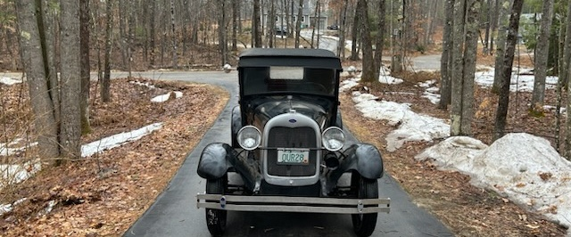
1928 FORD MODEL A COUPE
FOR SALE • $9,500 OR BEST OFFER
A SPECIAL FAMILY PROJECT
This 1928 Ford Model A Coupe was my dad’s project. He loved restoring antique cars and took great pride in his work. Following his passing, our family hopes to find a new owner who will appreciate this special antique automobile and give it a new home.
VEHICLE DETAILS
INTERESTED?
• Registered & runs
• Antique restoration project /interior finish work needs completion
• Garaged in Central NH
Julie • 339-200-9622
Julie.giglia@gmail.com
SERIOUS INQUIRIES ONLY

